Slide 1
IMDB and CHLN
By Pete, Steve, Al ex, Jefe

Slide 2
Overview
Our proposed group project is to create a data visualization tool that will allow a user to explore a large dataset of films in order find a movie that they want to want watch.
The app will make suggestions that may appeal to the user by taking user input and displaying relational data through visualization.

Slide 3
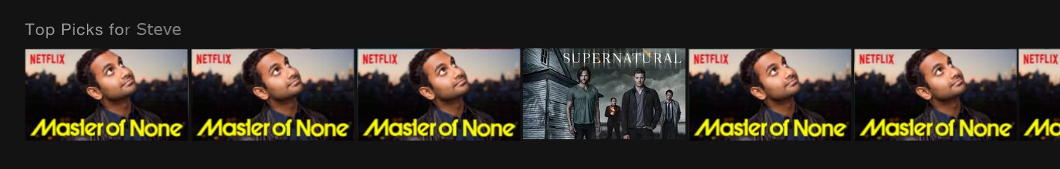
Familiar?

Slide 4
Domain Situation
This will be a web app that will help solve the issue of users trying to determine which movie to watch.
Using a large tabular dataset of over 5000 films, with supplemental information from the OMDB API.

Slide 5
Task Abstraction
The task that user is doing is searching the data. The data is refined by user inputs. Once a target is found, they can query the data to see additional attributes.
We plan to abstract from the domain specific data in the table to a more usable form for our goal – we will be creating a network out based on the similarities between the movie data contained in the dataset.

Slide 6
Querying: Three main principles
Identify
The tool and the user will work in tandem to identify what films the user would be most interested in.
Compare
The vis idiom will utilize the appropriate channels(e.g. size, colour) to emphasize similarities and differences between the prospective suggestions.
Summarize
The tool allows the user to view information on all of the possible films that they have identified. Provides data on the films such as genre, director, plot summary, etc…

Slide 7
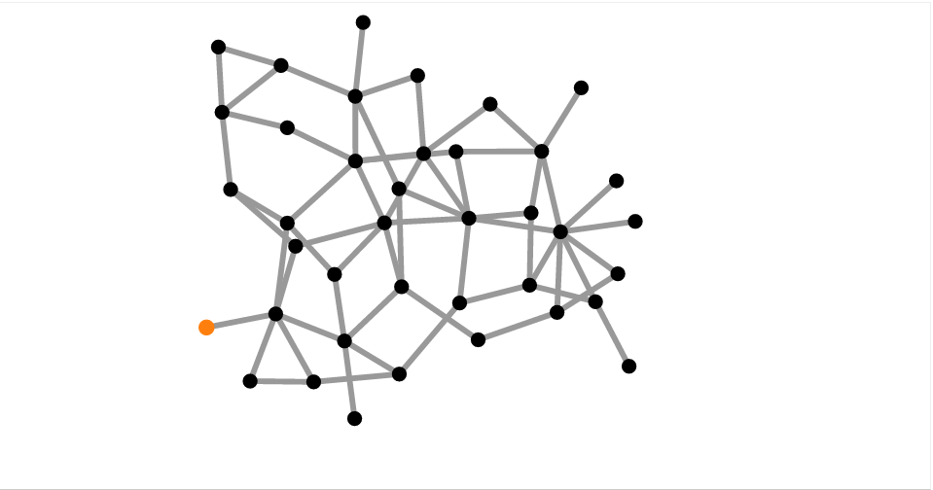
Idiom Example

Slide 8
Questions?
Give us good suggestions (please)

